Slide 1
Keyos
Stock Market App
By John Hakim, Noel Johny, Jace LeComte, Orlando Marino and Yousif Kashat

Slide 2
Goal & Requirements
A website that provides financial insight.
Display relevant information that is valuable for investors.
Forecast buying and selling points of specific stocks.
Users must pay a fee to access stock forecasts.
Users are notified when stocks are optimal buy/sell

Slide 3




Collaboration and Development Tools
Google Drive
Use Team Drive to keep all documents organized and allow for collaborative work
Trello
Keep track of sprint goals and tasks (SCRUM)
GroupMe & Slack
Primary method of communication
Github
Revision management and software development platform
Visual Studio
PyCharm
Notepad ++
Postman

Slide 4
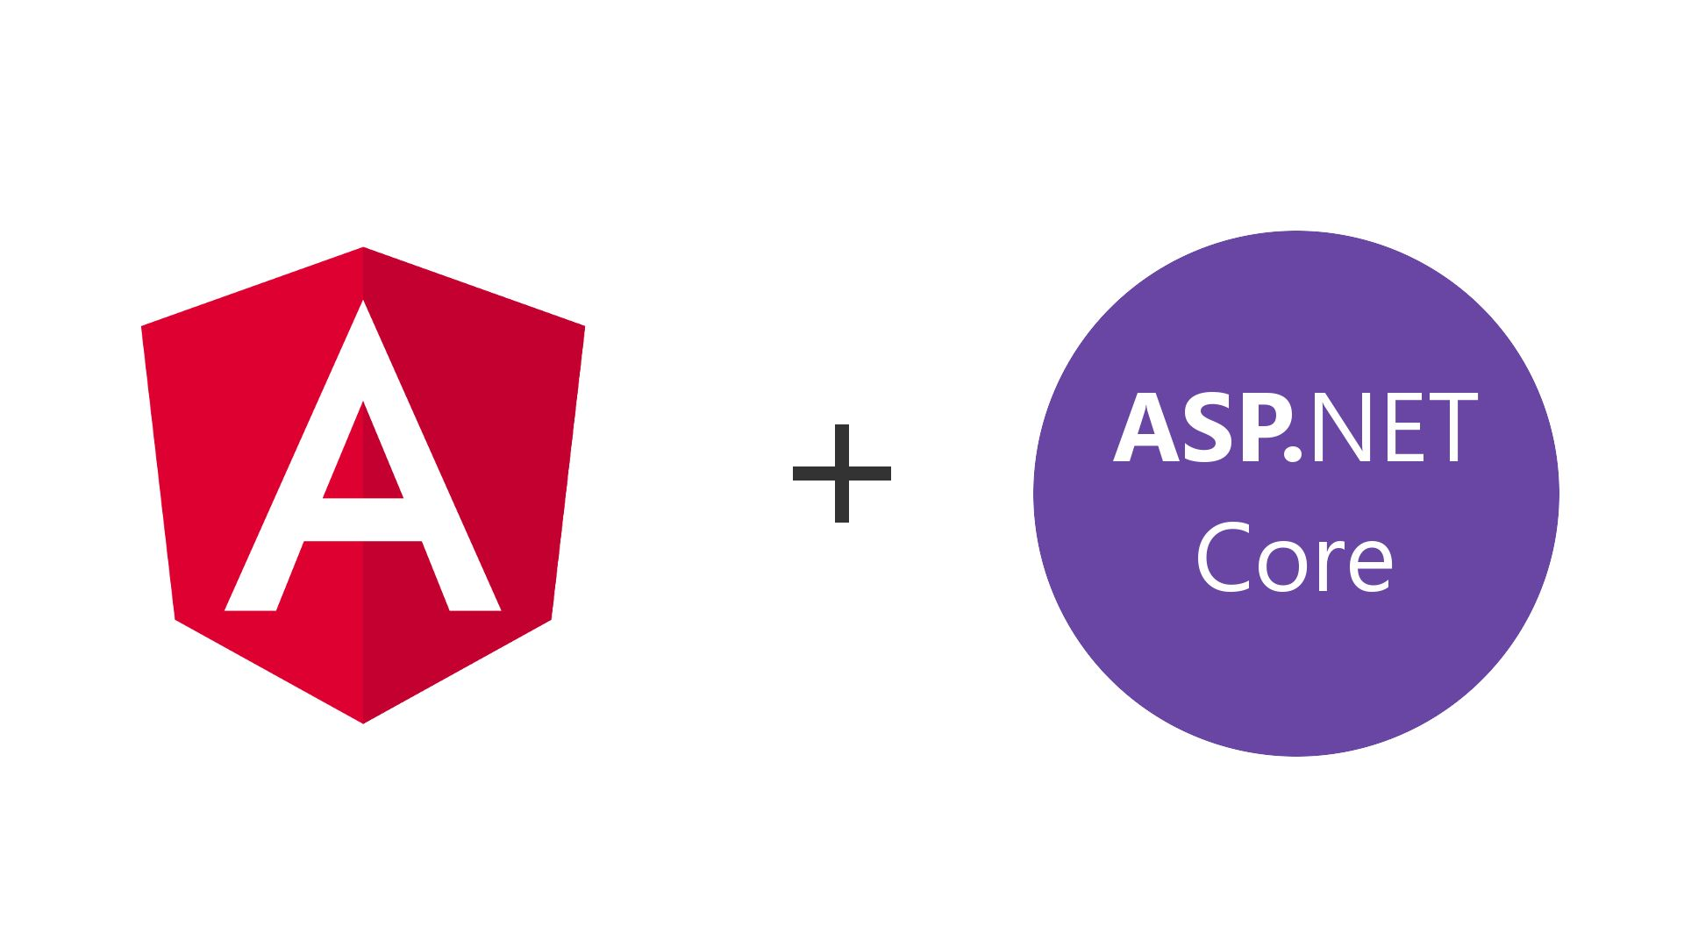
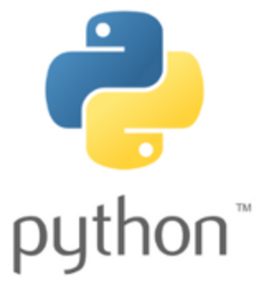
Architectural Overview
FrontEnd - Angular 7
Frontend javascript framework.
Backend - .Net core Web Api
open source, cross platform, secure authentication.
ML Backend - Python
Python-
Simple to learn and implement.
Powerful high-level programing language great for big data sets, and machine learning.
Python also has a very extensive set libraries.

Slide 5
Python - Backend Libraries
Stocker: a stock analysis and prediction toolkit that uses additive models
Pandas: high performance, easy to use data structures that include data analysis tools which will allow us to more effectively review and manipulate data
Numpy: library for numerical programming
Scipy: another library that will be used for mathematics and numerical programming
QuantPy: library that will be used for quantitative finance
Pynance: allows for retrieving, analyzing and visualizing data from stock market
Zipline: an event driven system for backtesting
Matplotlib: in the case that Pynance does not provide us with the visualizations we desire
Tensorflow: provides machine learning features

Slide 6
Next Sprint Objectives
Finish all user stories
Design User Interface
Create all QA test for user authentication system
Use Object Oriented Design and Computational Analysis to architect the software
Begin implementing algorithms used for the back end predictive models
Extract the necessary data for the back end computations
Role Management
Outline and update project documentation

Slide 7
Risks and Challenges
Balancing time in learning as we go, while still completing our user stories for the week.
Coordinating schedules to maximize efficient team effort and synergy
Assigning roles for specific tasks to be accomplished
Staying organized and focused on the end goal
Using our time efficiently and productively
Not wasting effort on overly ambitious sprints
Have the ability to break down problems when all components are being merged
Predicting future outcomes is never guaranteed especially for stocks and crypto currency.
Overtraining our algorithm with large datasets

Slide 8
Q&A?

